Slide 1

TRAFFIC CONTROL SYSTEM
Team members:
Ibrahim afnan – (2003A52013)
Mohd shareeq – (2003a52060)
Submitted to:
K. Balakrishna
Asst. prof.(Dept of Cse)

Slide 2
CONTENTS
Road infrastructure has seen consistent improvement in the last few years. Connectivity has improved and road transportation has become a focus of rapid development. In metropolitan cities traffic congestion is increasing rapidly, it results in chronic situation in dense downtown areas. Traffic signals play a significant role in the urban transportation system. They control the movement of traffic on urban streets by determining the appropriate signal timing settings. Traffic control systems are widely used to monitor and control the flow of automobiles through the junction of many roads.

Slide 3
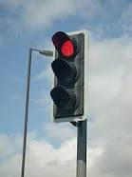
OBJECTIVE
Roads without any supervision or guidance can lead to traffic conflicts and accidents.
Traffic signals are required for an orderly flow of traffic.
Traffic lights allow everyone to cross intersection point one by one, reducing conflicts b/w vehicles entering intersection points from different directions.
It provides road safety, also helps to solve traffic in simple manners

Slide 4
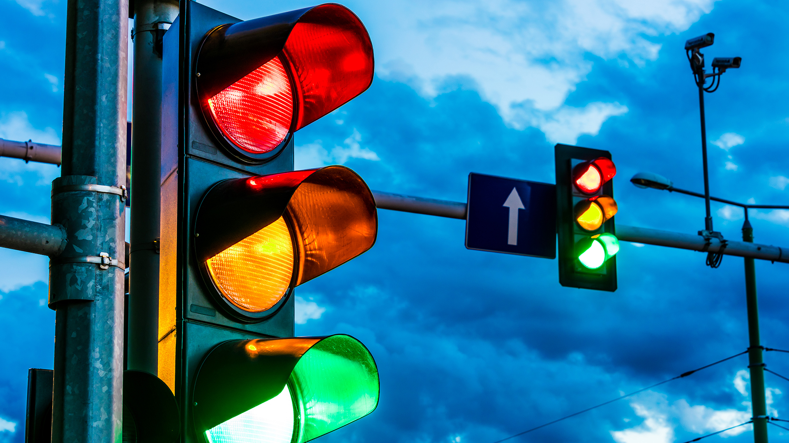
There are different colours in traffic lights. Each light has a meaning, and these lights tell drivers what to do
They are located at intersections and intersections of the road
Light traffic signals play a major role in the traffic flow

Slide 5
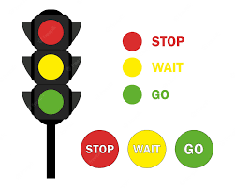
In order to preserve decorum, such traffic signals control the movement and flow of traffic.
Red light ON- A driver should stop.
Yellow light ON- A driver has to slow down and be ready to stop
Greenlight ON- A driver can start driving or keep driving

Slide 6
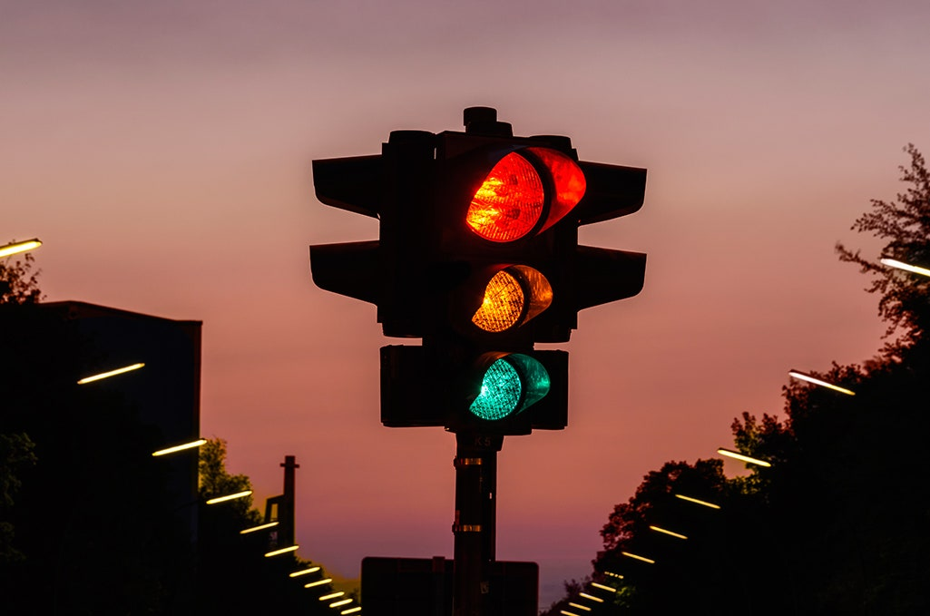
In this project we are going to create a Button Group such that it contains three radio buttons Red, Yellow, Green when red is clicked it need to display “Stop!”, when yellow is clicked it need to display “Get Ready to go!”, when the green button is clicked Display “Go.

Slide 7
Elements used in the Project
JFrame: The javax.swing.JFrame class is a type of container which inherits the java.awt.Frame class. JFrame works like the main window where components like labels, buttons, textfields are added to create a GUI. Unlike Frame, JFrame has the option to hide or close the window with the help of setDefaultCloseOperation() method.
JLabel: The object of JLabel class is a component for placing text in a container. It is used to display a single line of read only text. The text can be changed by an application but a user cannot edit it directly. It inherits JComponent class.
JButton: The JButton class is used to create a labeled button that has platform independent implementation.
setLayout( ): Sets the LayoutManager. Overridden to conditionally forward the call to the contentPane.
setVisible(): Shows or hides this Window depending on the value of parameter Boolean b.

Slide 8
ActionListener( ): The listener interface for receiving action events. The class that is interested in processing an action event implements this interface, and the object created with that class is registered with a component, using the component's addActionListener method. When the action event occurs, that object's actionPerformed method is invoked.
addItem( ): Adds an item to the item list. This method works only if the JComboBox uses a mutable data model.
setText( ): Defines the single line of text this component will display. If the value of text is null or empty string, nothing is displayed.

Slide 9
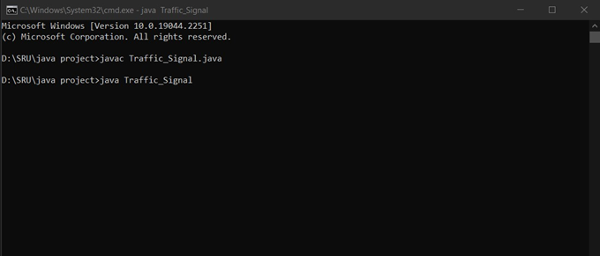
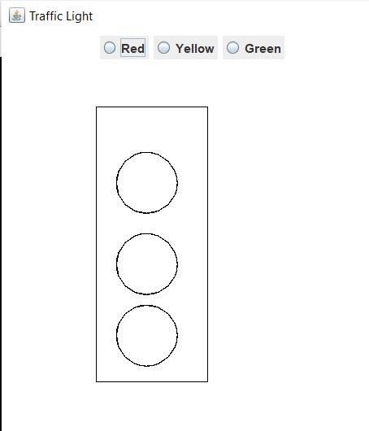
Screens, Test Cases and Test Results
Fig: Compilation of project
Fig: Initial output of project

Slide 10
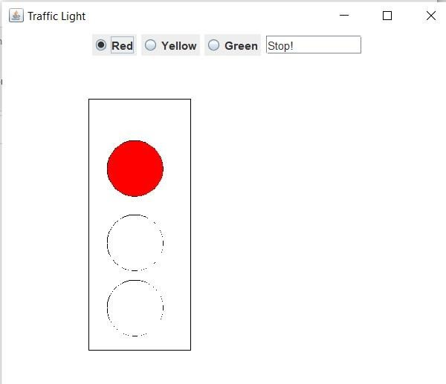
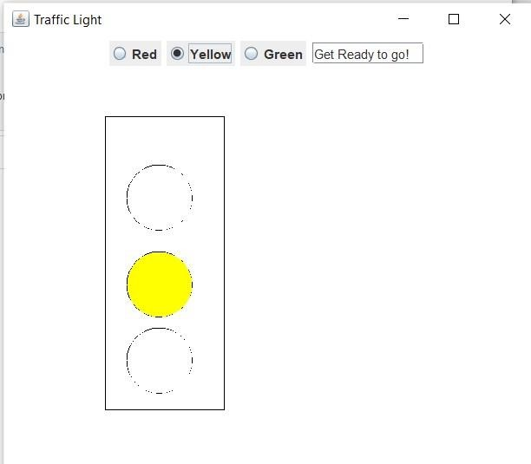
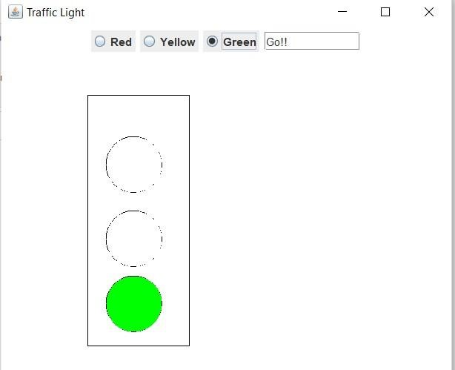
Screens, Test Cases and Test Results
Fig: Output which shows the RED signal
Fig: Output which shows the YELLOW signal
Fig: Output which shows the GREEN signal

Slide 11
CONCLUSION
Traffic jam is the common phenomena in city area. Traffic jam is obstructing for trade and commerce also waste valuable time. The main reason of traffic jam can be not maintained traffic rules, faulty traffic signalling systems. Faulty traffic signalling systems, inadequate manpower and narrow road spaces and overtaking tendency of drivers create pro-longed traffic congestions and intensify sufferings of commuters keeping people motionless as well as creating suffocating condition in the streets. So, if we want to overcome this problem, we must install a modern traffic controller system also grow up the tendency of maintaining traffic rules

Slide 12


